Slide 1
PSPACE and beyond
Aaron Bloomfield
CS 4102
Spring 2011

Slide 2
PSPACE

Slide 3
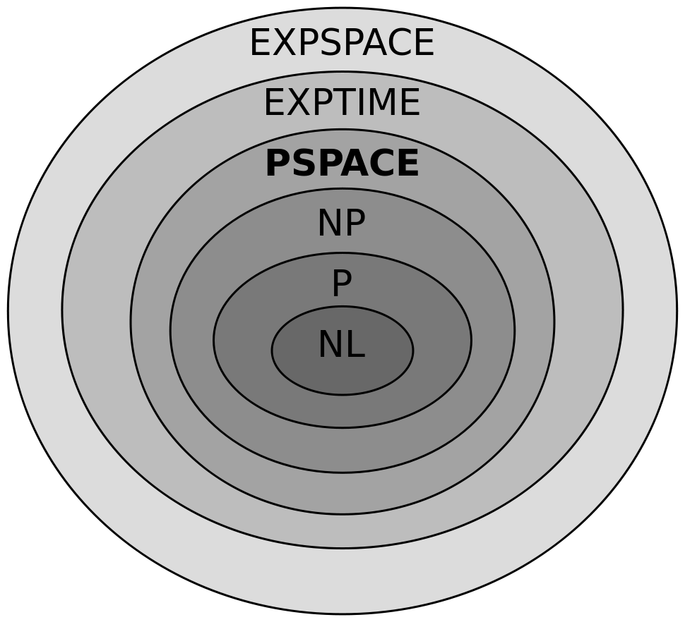
Complexity classes

Slide 4
An aside: L and NL
L (a.k.a. LSPACE) is the set of algorithms that can be solved by a DTM in logarithmic space
NL (a.k.a. NSPACE) is the set of algorithms that can be solved by a NTM in logarithmic space
L ⊆ NL ⊆ P
It is an open problem if L = NL
And if NL = P
We can’t do a polynomial-time reduction for these complexity classes
We need log-space reductions instead…

Slide 5
“Exponential” complexity classes
There are many complexity classes that take up an exponential amount of time
And only one (that we are seeing) that takes up an exponential amount of space
Notes:
From http://en.wikipedia.org/wiki/List_of_NP-complete_problems#Games_and_puzzles

Slide 6
PSPACE
PSPACE is the class of problems that take up a polynomial amount of space
It may take polynomial time or exponential amount of time

Slide 7
P ⊆ PSPACE
An algorithm in P takes a polynomial number of steps
And each step writes (at most) one symbol to the TM
So it can never take up more than a polynomial amount of space

Slide 8
Exponential algorithms & polynomial space
An exponential algorithm can still take up a polynomial amount of space
Consider a counter from 1 to 2^{n}
Just do bit-wise addition from 000000 to 100000, reusing the space
Here, n = 5, space = 5, steps = 32
This algorithm uses n space and 2^{n} steps
That being said, an exponential algorithm can also take up an exponential amount of space…

Slide 9
NP ⊆ PSPACE
To show this, consider the following statement:
There is an algorithm that solves SAT in polynomial space
Go through every possibility – takes n space, and 2^{n} steps
Reuse space, as described on the previous slide
If any NP-complete problem is in PSPACE, then they all are

Slide 10
NPSPACE = PSPACE
Adding non-determinism to the TM does not take up any more space
Even though it may take up more time
We can simulate a NTM on a DTM without needing more than a polynomial increase in space
Even though there is a (potentially) exponential increase in the number of states

Slide 11
PSPACE-complete

Slide 12
PSPACE-complete
What we are interested in is the set of problems that are in PSPACE, but are not believed to be in NP

Slide 13
PSPACE-complete vs. NP-complete
PSPACE-complete problems take exponential time to deterministically compute the result
Just like NP-complete problems
Either the decision or functional problem versions
But PSPACE-complete problems also take exponential time to deterministically verify the result
NP-complete can verify a solution in polynomial time

Slide 14
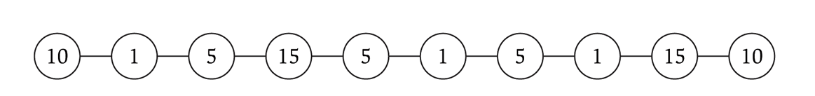
Competitive facility location
Competitive facility location
Consider a graph G, where two ‘players’ choose nodes in alternating order. No two nodes can be chosen (by either side) if a connecting node is already chosen. Choose the winning strategy for your player.

Slide 15
Competitive facility location
To determine the solution, you need to consider all possible game paths
i.e., enumerate the game paths in the game tree
Given a solution, to see if it is the best solution, you have to do the same thing
i.e., consider all possible game paths

Slide 16
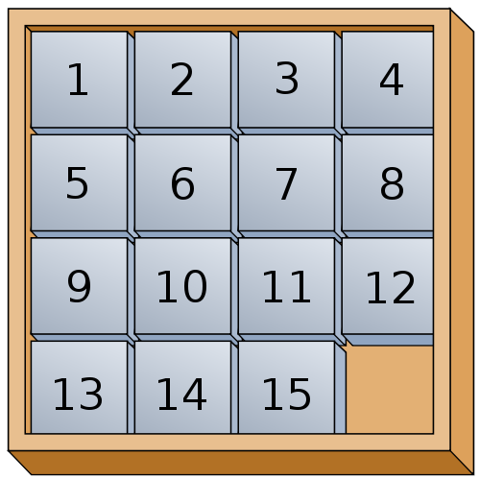
Planning
Given a scrambled 15-puzzle, how to you solve it?
Given a solution, you can easily verify that it solves the puzzle
But to determine if it’s the quickest solution, it takes exponential time
You can use Dijkstra’s shortest path, but the graph size is exponential

Slide 17
QSAT
A variant of SAT, but using quantifiers
The original SAT problem:
∃x₁ ∃x₂ … ∃x_{n-1} ∃x_{n} ∴ Φ(x₁, …, x_{n})?
Given a SAT formula: Φ(x₁,x₂,x₃) = (x₁∨x₂∨x₃)∧(x₁∨x₂∨x₃)∧(x₁∨x₂∨x₃)∧(x₁∨x₂∨x₃)
We ask: ∃x₁ ∀x₂ ∃x₃ ∴Φ(x₁,x₂,x₃)?
We can see there is: we set x₁ so that for both choices of x₂, there is a value for x₃ such that Φ is satisfied
Specifically, we set x₁ to 1; if x₂ is 1, we set x₃ to 0; if x₂ is 0, we set x₃ to 1

Slide 18
QSAT solver, part 1 (for ∃)
If the first quantifier is ∃x_{i}, then
Set x_{i}=0, and recursively evaluate the rest of the expression
Save the result, and delete all other intermediate work
Set x_{i}=1, and recursively evaluate the rest of the expression
Save the result, and delete all other intermediate work
If either outcome yielded a 1, then return 1
Else return 0
Endif

Slide 19
QSAT solver, part 2 (for ∀)
If the first quantifier is ∀x_{i}, then
Set x_{i}=0, and recursively evaluate the rest of the expression
Save the result, and delete all other intermediate work
Set x_{i}=1, and recursively evaluate the rest of the expression
Save the result, and delete all other intermediate work
If both outcomes yielded a 1, then return 1
Else return 0
Endif

Slide 20
Time usage
Each recursive call takes p(n) time
Each of the n steps (one for each x_{i}) will yield two recursive calls, for a total of 2^{n} invocations
Total time is p(n)⋅2^{n}

Slide 21
Space usage
The recursive calls for x_{i}=0 and x_{i}=1 use the same space (which we’ll claim is p(n))
So the space needed is p(n) plus the recursive call
Recurrence relation:
S(n) = S(n-1) + p(n)
S(n) = n⋅p(n)
Which is polynomial

Slide 22
Competitive facility location
It reduces quite easily to/from QSAT!

Slide 23
Tic-tac-toe
Is PSPACE-complete
A simple upper bound on the number of boards is 3⁹ = 19,683 (each cell can have an X, an O, or be blank)
A better estimate (only legal boards, ignoring rotations) is 765
The game tree size is O(n!) = 9! = 362,880
A more reasonable estimate (only legal boards, ignoring rotations) is 26,830

Slide 24
m,n,k-game
An m,n,k-game has a m×n board, alternating players, and the first one to get k in a row wins
Tic-tac-toe is a 3,3,3-game
The entire game tree only needs m×n space
As we recursively look through the game tree, we use the same board
This puts it in PSPACE
With more work, it can be shown to be PSPACE-complete

Slide 25
EXPTIME

Slide 26
EXPTIME
The set of all problems that are solvable in 2^{p(n)} time by a DTM
NEXPTIME is the set of all problems solvable in 2^{p(n)} time by a NTM
Where p(n) is a polynomial function of n
Superset (strict?) of P and NP

Slide 27
EXPTIME-complete example
Does a DTM always halt in k (or fewer) steps?
Determining if the DTM halts at all is intractable (the Halting Problem)
But we can tell if it halts in k steps by simulating all possible executions of the DTM through k steps

Slide 28
EXPTIME-complete vs. NP-complete
NP-complete problems can be solved on a DTM in p(n)⋅2^{n} time
EXPTIME-complete problems can be solved on a DTM in p(n)⋅2^{q(n)} time
While p(n) is polynomial, q(n) may be exponential
But can greater than n
p(n)⋅2^{n^5} is a running time for a EXPTIME-complete problem; it’s outside a NP-complete problem
As an worst-case NP-complete algorithm can iterate through all possible solutions in 2^{n} time, and verify each one in p(n) time, for a running time of p(n)⋅2^{n}

Slide 29
EXPSPACE

Slide 30
EXPSPACE
The set of all problems solvable in 2^{p(n)} space
Strict superset of PSPACE
And thus of P and NP
Believed to be a strict superset of EXPTIME

Slide 31
EXPSPACE-complete example
Recognizing whether two regular expressions represent different languages
Where the operators are limited to four: union, concatenation, Kleene star, and squaring
Without Kleene star, it becomes NEXPTIME-complete

Slide 32
Game Complexity

Slide 33
Known to be NP-complete
Battleship
Master Mind
Crossword construction
FreeCell
Sudoku
Tetris
Notes:
From http://en.wikipedia.org/wiki/List_of_NP-complete_problems#Games_and_puzzles

Slide 34
Known to be in PSPACE…
… but unknown if they are in a lower complexity class, or if they are PSPACE-complete
Sim
Pentominoes
Connect Four
Quoridor
Notes:
http://en.wikipedia.org/wiki/Game_complexity

Slide 35
Known to be PSPACE-complete
Tic-tac-toe
Qubic
Reversi
Hex (11x11)
Gomoku
Connect6
Amazons (10x10)
Notes:
http://en.wikipedia.org/wiki/Game_complexity

Slide 36
Known to be in EXPTIME…
… but unknown if they are in a lower complexity class, or if they are EXPTIME-complete
Fanorona
Nine Men’s Morris
Lines of Action
Arimaa
Notes:
http://en.wikipedia.org/wiki/Game_complexity

Slide 37
Known to be EXPTIME-complete
Checkers (both 8x8 & 10x10)
Chinese checkers (both 2 sets and 6 sets)
Chess
Shogi
Go (19x19)
Notes:
http://en.wikipedia.org/wiki/Game_complexity

Slide 38
Complexity Zoo (courtesy of Gabe Robins)

Slide 39
The Extended Chomsky Hierarchy Reloaded
2^{Σ*}
Decidable Presburger arithmetic
…
…
…
…
…
EXPSPACE
?
H
H
…
…
…
…
EXPTIME
…
…
…
Turing
…
…
PSPACE
…
PH
BPP
degrees
…
…
…
…
…
…
…
…
…
…
…
Context sensitive LBA
…
…
…
…
NP
…
…
…
…
…
…
…
…
…
…
…
…
P a^{n}b^{n}c^{n}
…
…
…
…
…
…
Not finitely describable
…
…
EXPSPACE-complete =RE
Context-free ww^{R}
PSPACE-complete QBF
EXPTIME-complete Go
Det. CF a^{n}b^{n}
Not Recognizable
NP-complete SAT
…
…
…
…
…
Regular a*
Recognizable
…
…
…
…
…
…
…
…
…
…
Finite {a,b}
…
…
…
…
…
Dense infinite time & space complexity hierarchies
…
…
…
…
Other infinite complexity & descriptive hierarchies
…
…
…
…
…
…

Slide 40


Slide 41
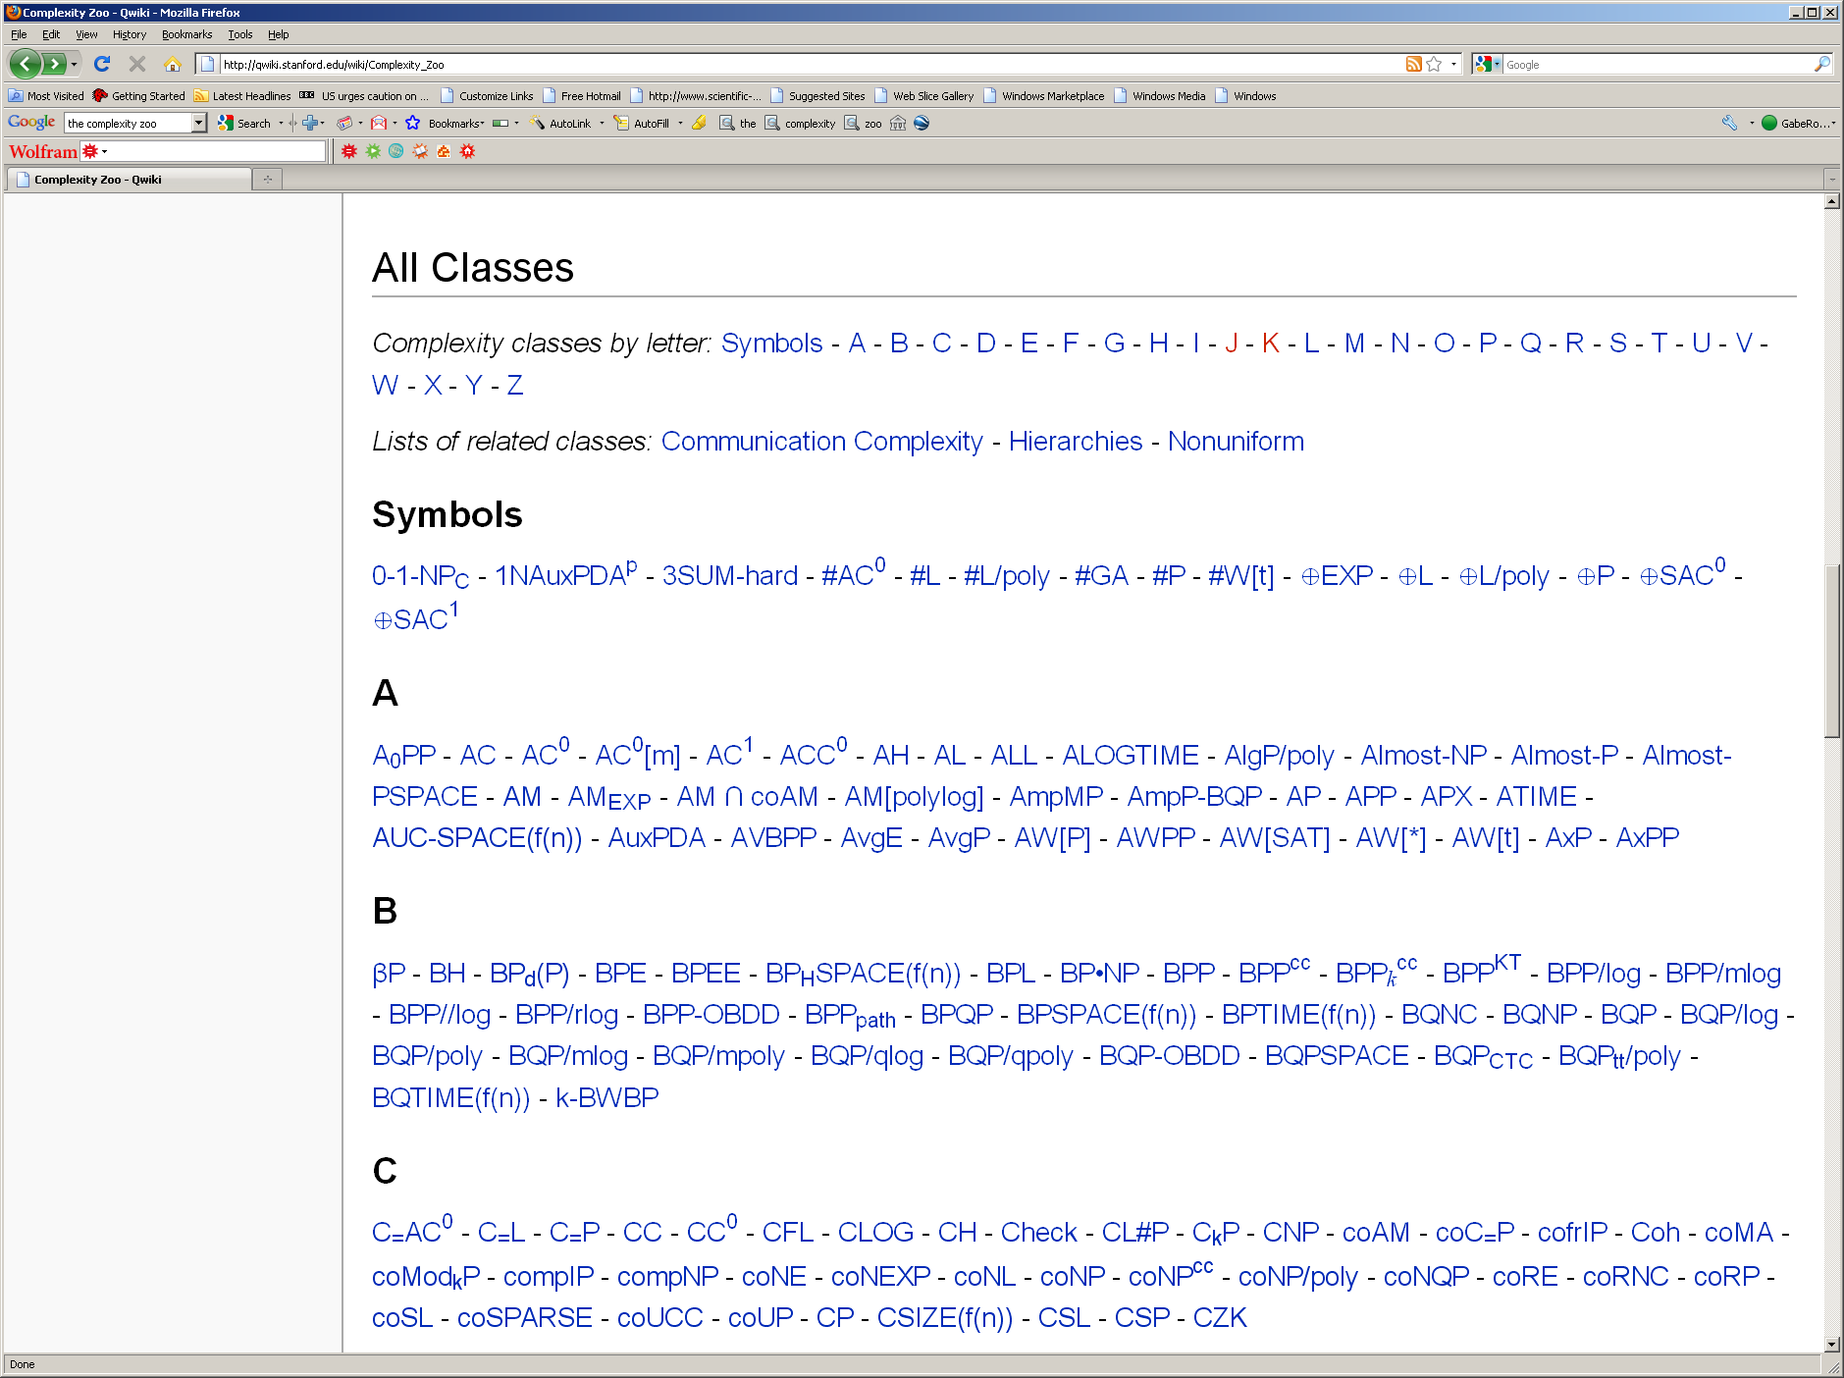

Slide 42
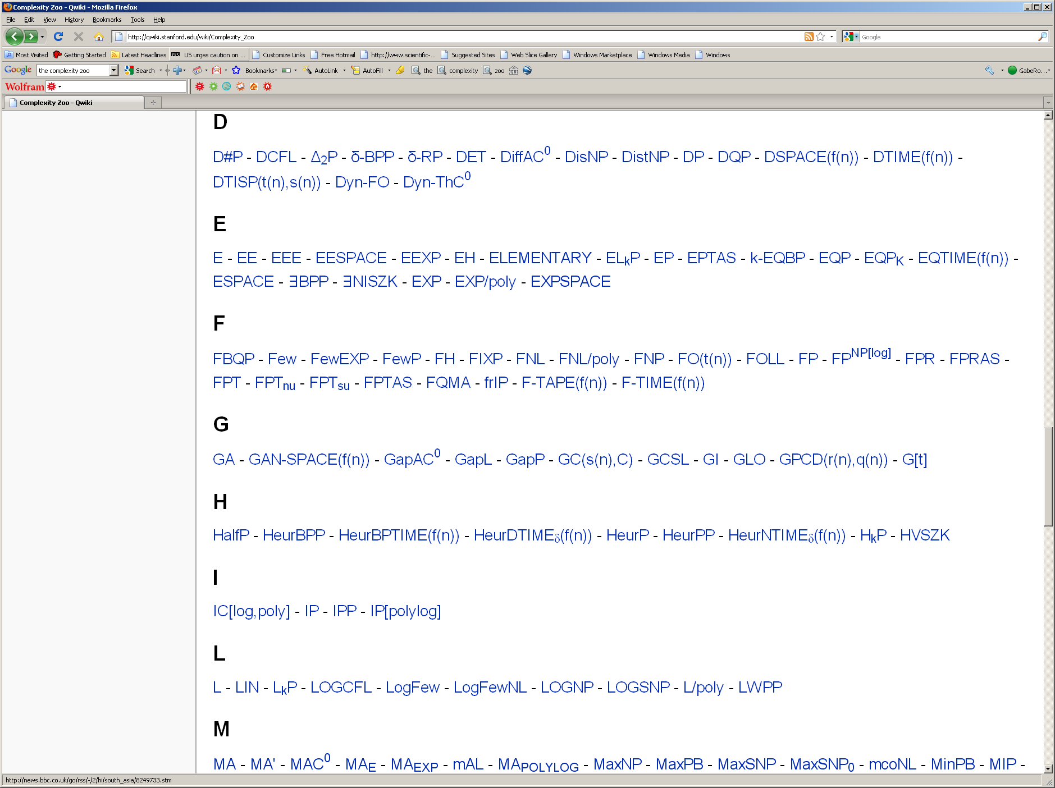

Slide 43
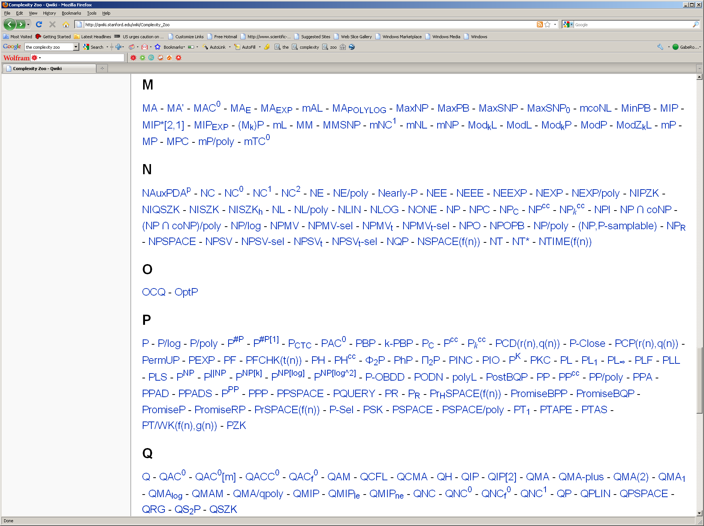

Slide 44
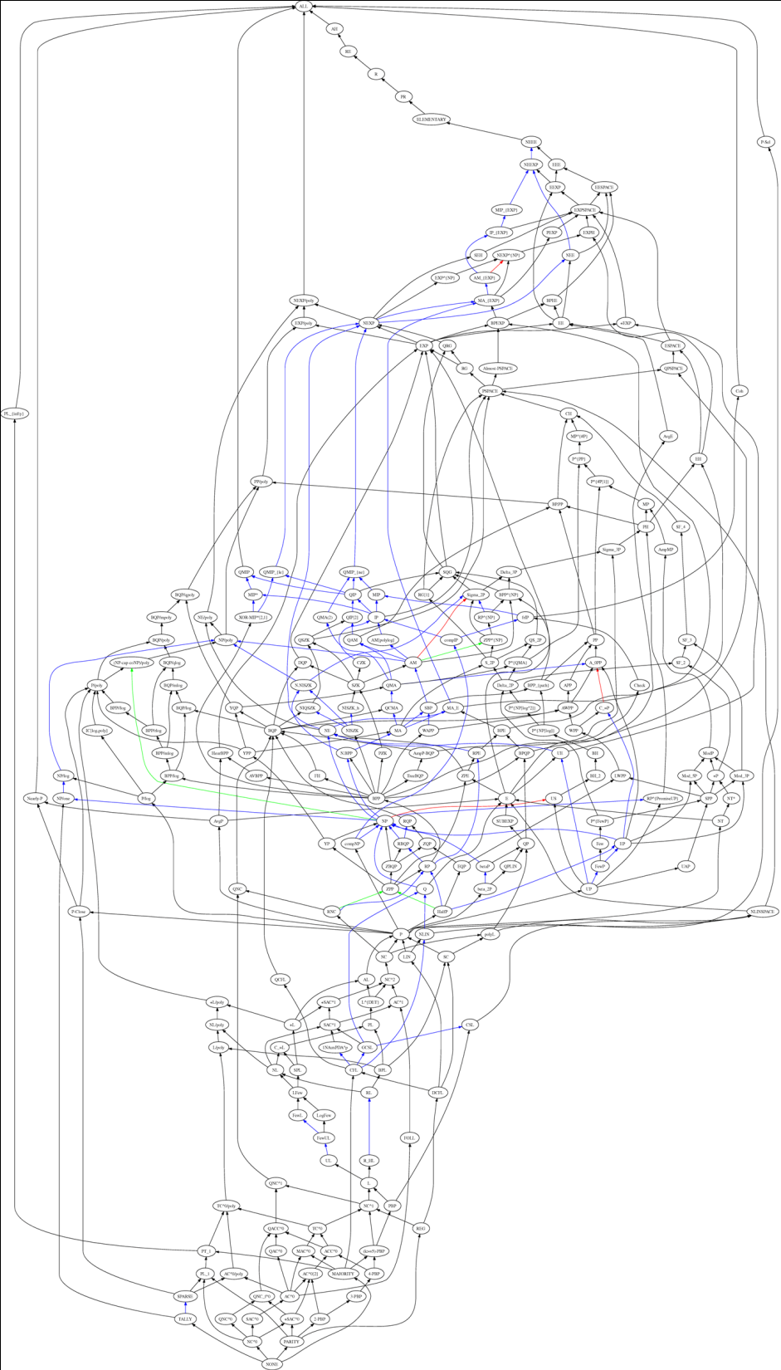


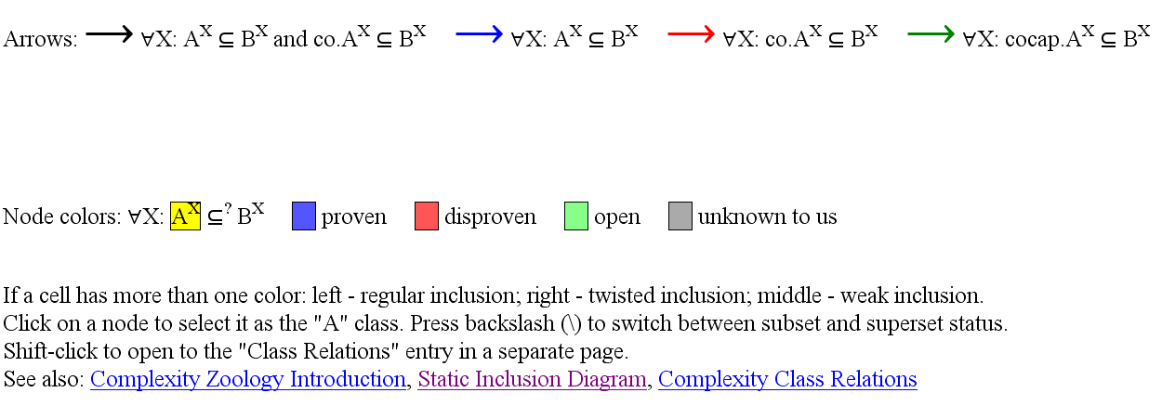
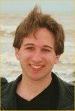
The “Complexity Zoo”
Class inclusion diagram
Currently 494 named classes!
Interactive, clickable map
Shows class subset relations
Legend:
http://www.math.ucdavis.edu/~greg/zoology/diagram.xml
Scott Aaronson

Slide 45
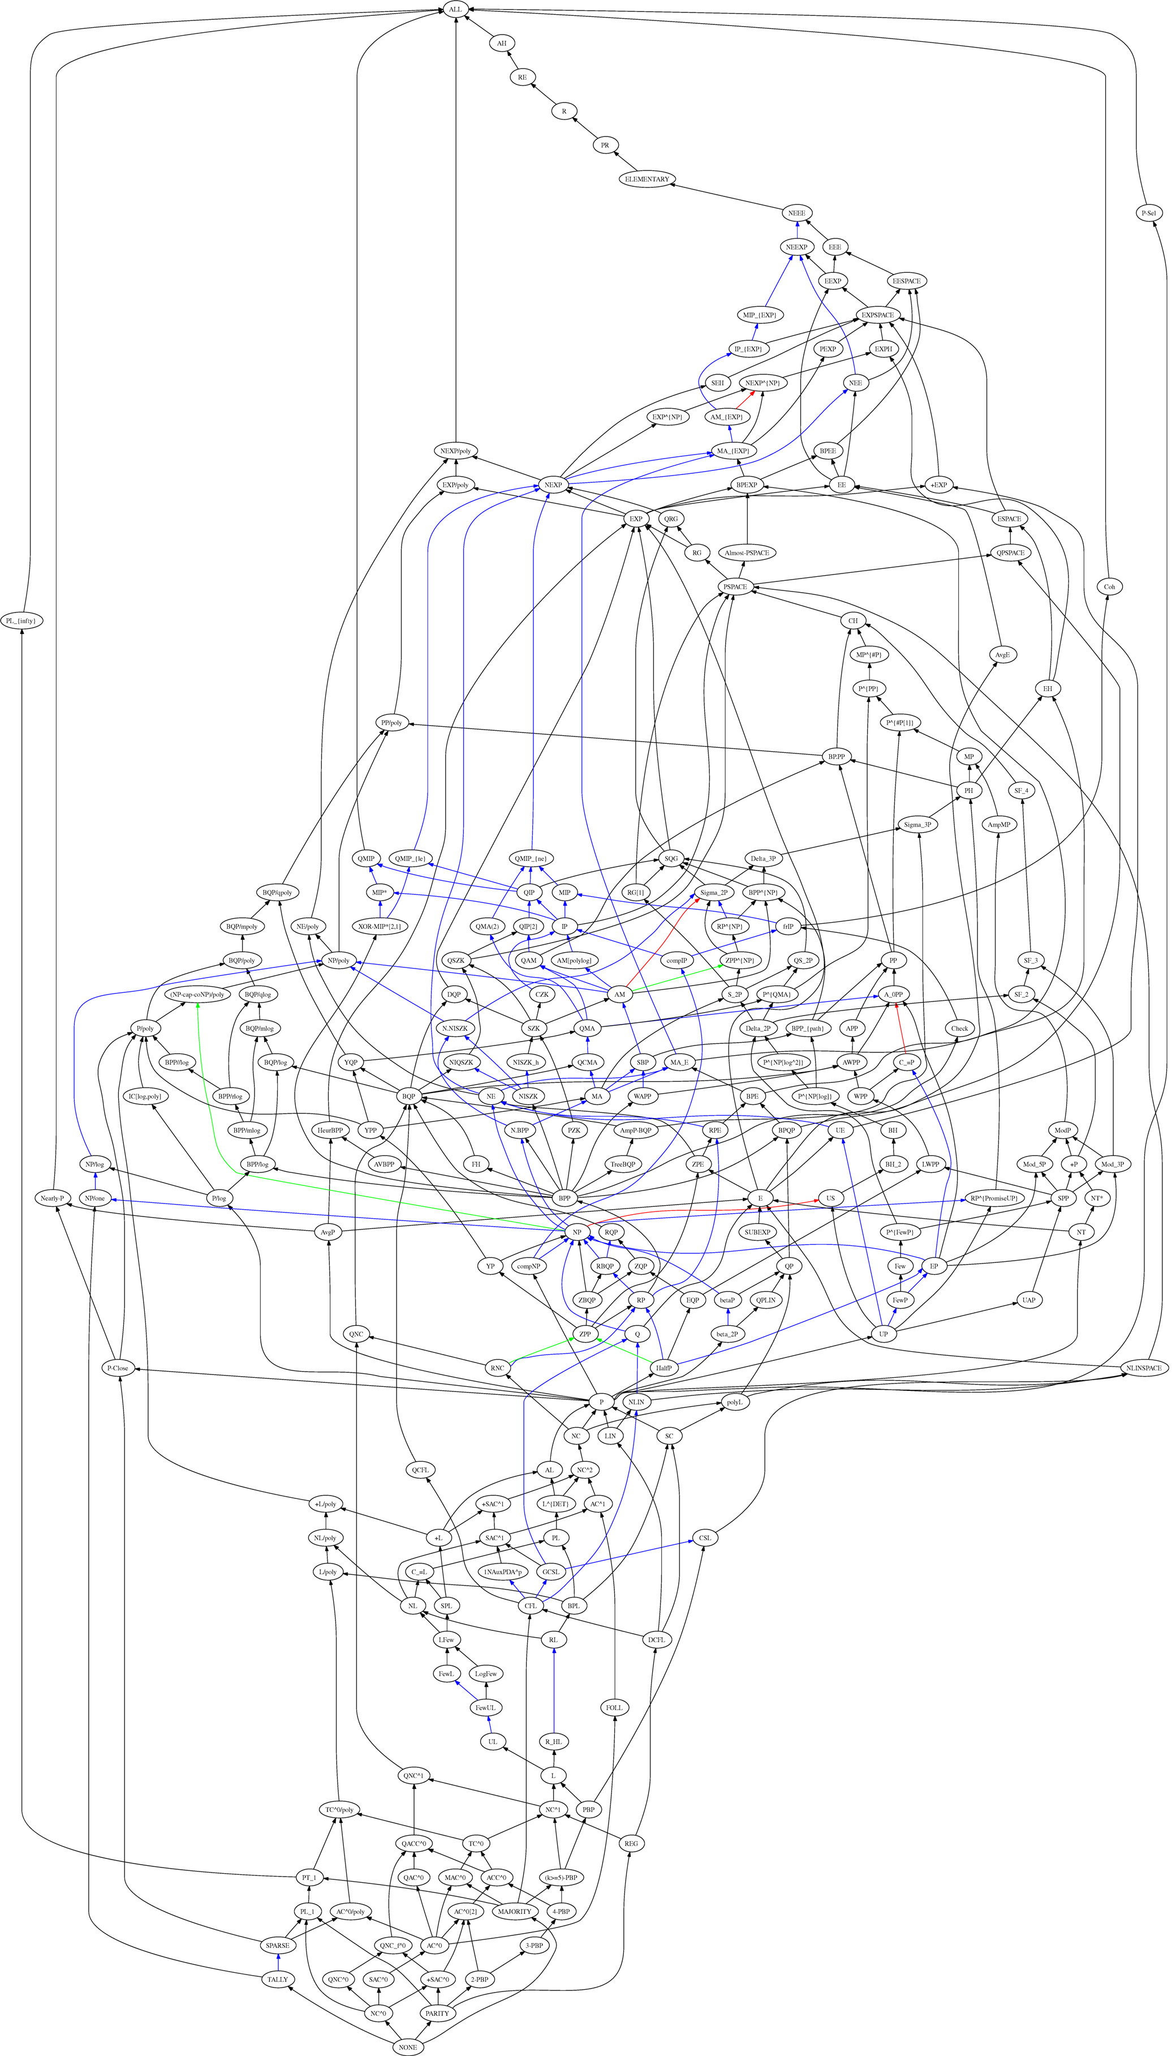

Slide 46
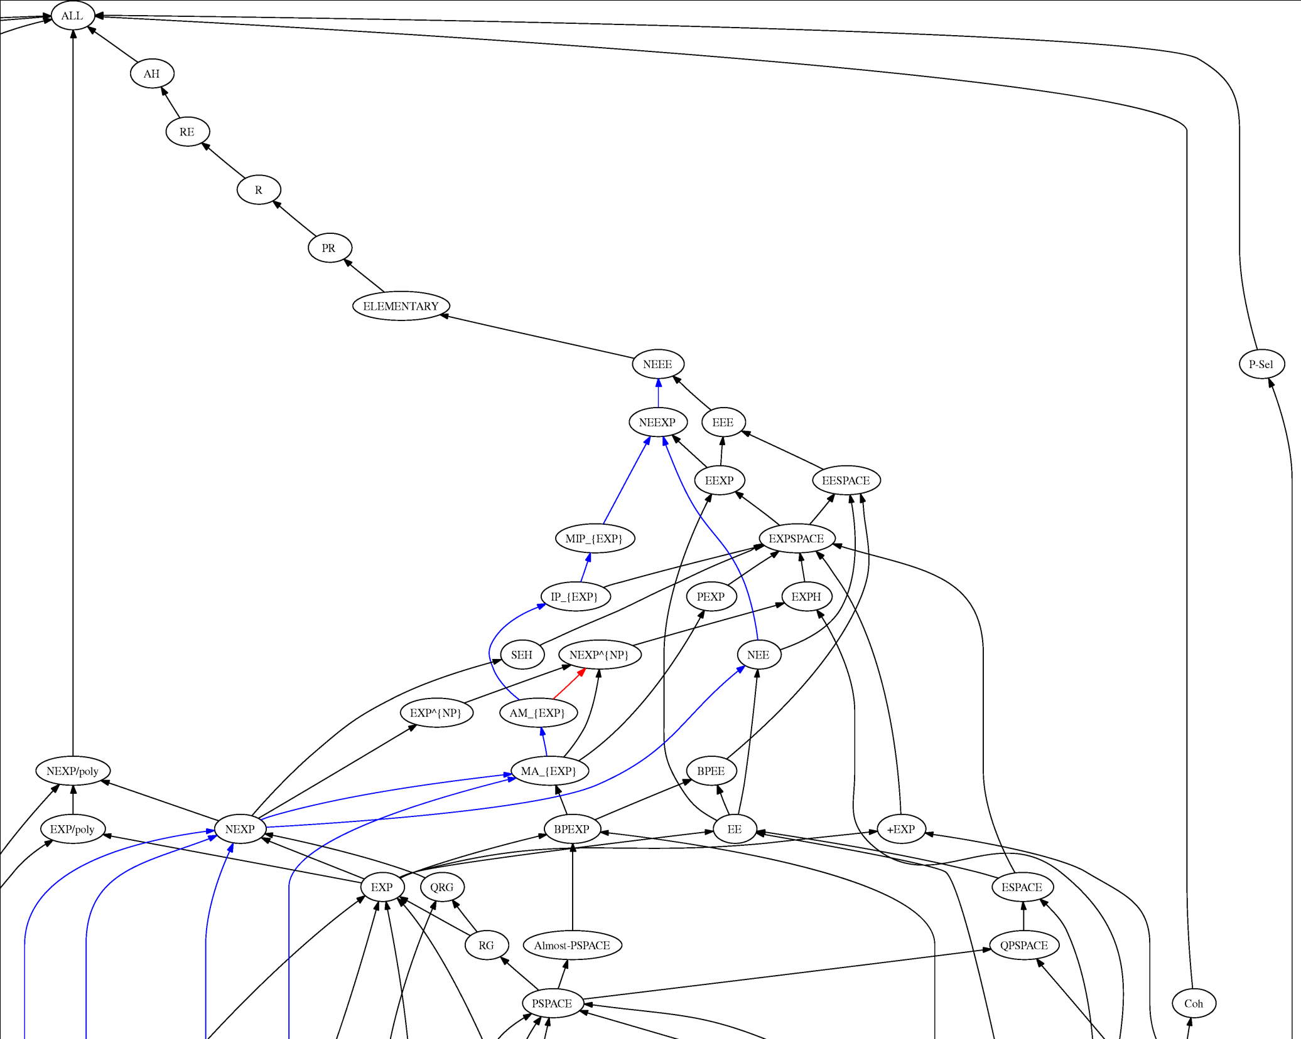
2^{Σ*}
Recognizable
Decidable
Exponential
space
Non-deterministic
exponential
time
Deterministic
exponential
time
Polynomial
space

Slide 47
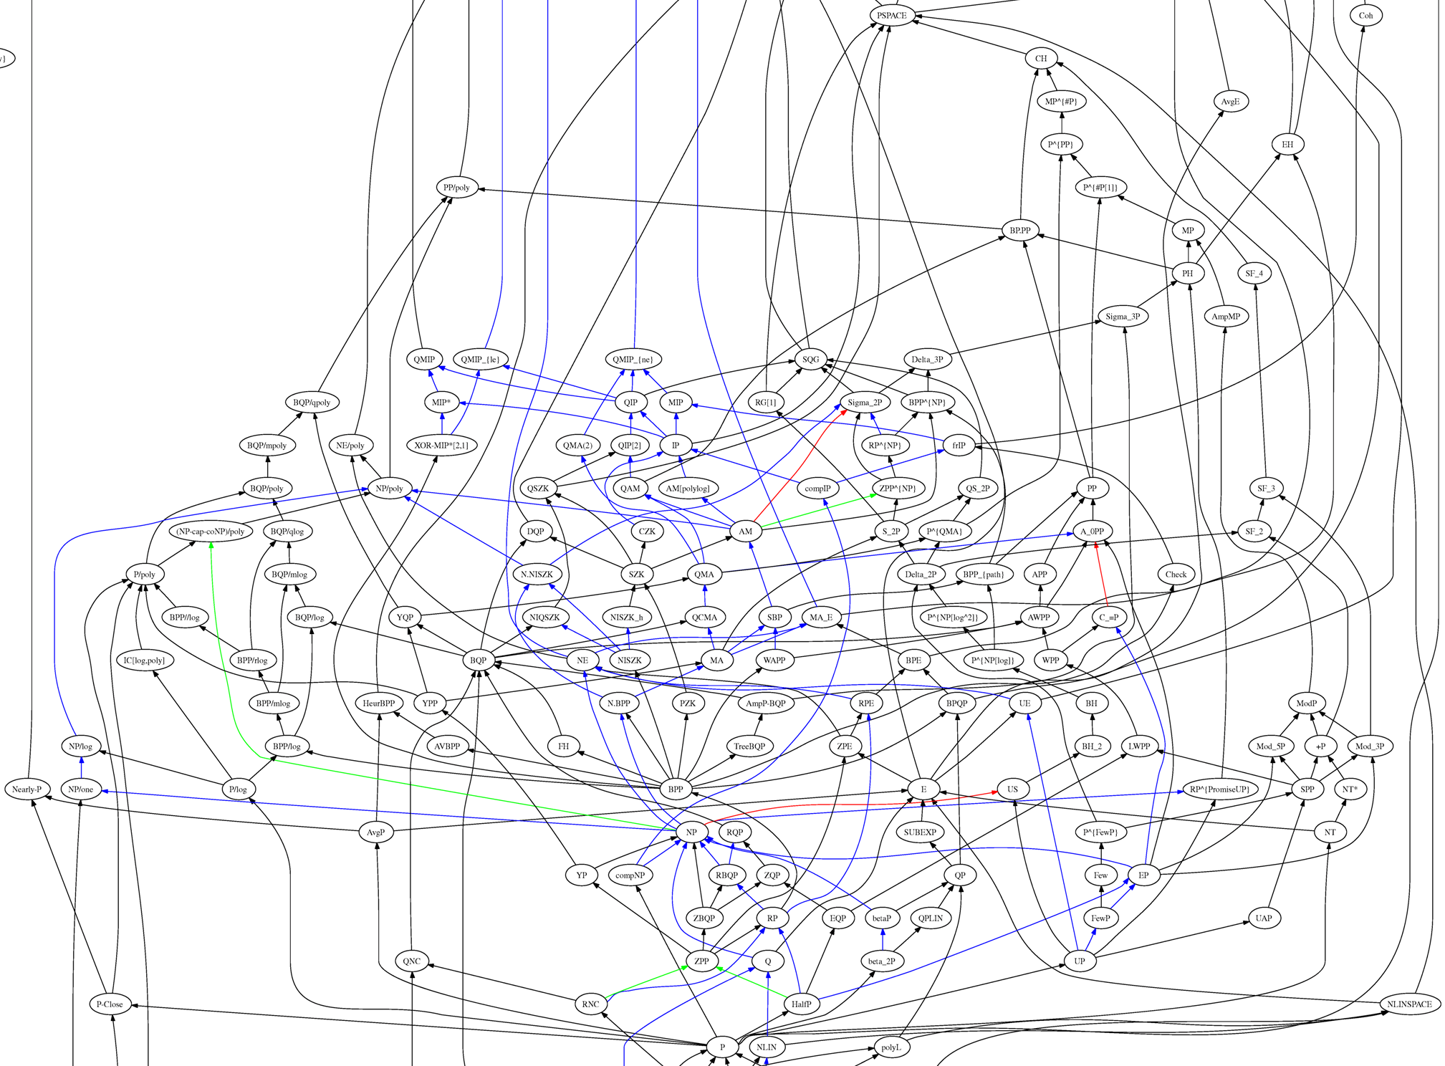
Polynomial
space
Polynomial
time hierarchy
Interactive
proofs
Non-deterministic
polynomial time
Deterministic
polynomial time
Non-deterministic
linear time
Non-deterministic
linear space

Slide 48
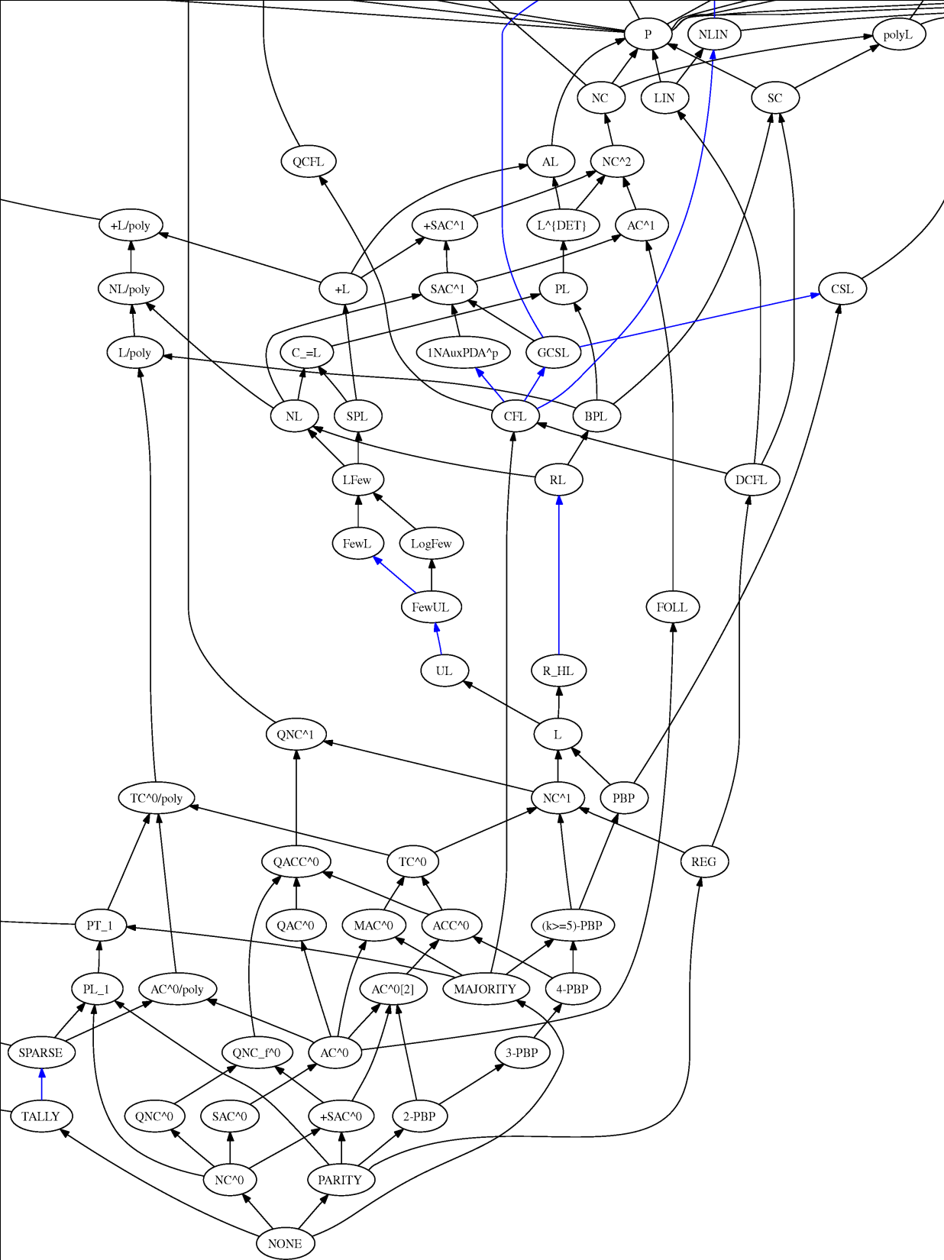
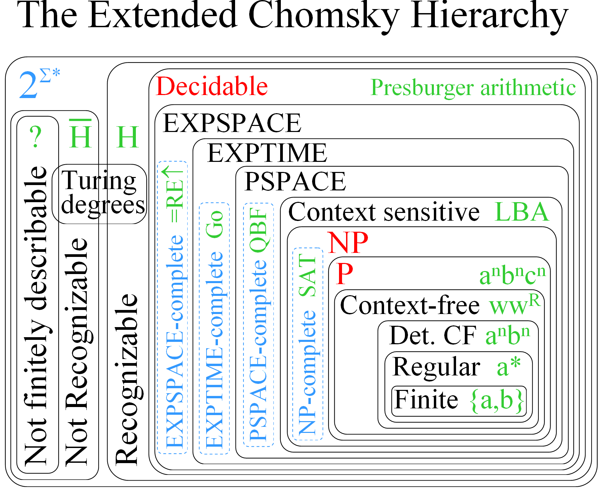
Deterministic
polynomial time
Poly-logarithmic time
Non-deterministic
linear time
Deterministic
linear time
Context-sensitive
Non-deterministic
logarithmic space
Context
free
Deterministic context-free
Deterministic
logarithmic space
Regular
Empty set

Slide 49
The Extended Chomsky Hierarchy Reloaded
2^{Σ*}
Decidable Presburger arithmetic
…
…
…
…
…
EXPSPACE
?
H
H
…
…
…
…
EXPTIME
…
…
…
Turing
…
…
PSPACE
…
PH
BPP
degrees
…
…
…
…
…
…
…
…
…
…
…
Context sensitive LBA
…
…
…
…
NP
…
…
…
…
…
…
…
…
…
…
…
…
P a^{n}b^{n}c^{n}
…
…
…
…
…
…
Not finitely describable
…
…
EXPSPACE-complete =RE
Context-free ww^{R}
PSPACE-complete QBF
EXPTIME-complete Go
Det. CF a^{n}b^{n}
Not Recognizable
NP-complete SAT
…
…
…
…
…
Regular a*
Recognizable
…
…
…
…
…
…
…
…
…
…
Finite {a,b}
…
…
…
…
…
Dense infinite time & space complexity hierarchies
…
…
…
…
Other infinite complexity & descriptive hierarchies
…
…
…
…
…
…

